Slide 1


Portfolio WebSite with React
Under The Supervision of:-
Mr. Ankit Arora (Technical Trainer)
Department of CEA
GLA University, Mathura
Presented By:-
Harsh Sharma(201500272)

Slide 2
Content
Introduction
Objective
Hardware And Software Requirement
Project Scope
Front-end Preview
Tools and Technology
Conclusion
References
10/09/22
2

Slide 3
INTRODUCTION
Welcome to this project report on the React Portfolio Website.The purpose of this project was to create a responsive React-based portfolio website, which can be used to showcase personal projects and skills.
The website was built using modern web development techniques, such as React, JavaScript, HTML, and CSS. In this report, we will provide an overview of the project, including its objectives, methodologies, and outcomes. Additionally, we will discuss the main features of the website and highlight some of the challenges encountered during the development process.
Finally, we will conclude the report with a reflection on the project, discussing its strengths and limitations, as well as potential future directions for the website. The project focuses on building a responsive portfolio website using React, a popular JavaScript library for building user interfaces. The website includes multiple pages and sections, such as a home page, about page, portfolio page, and contact page.

Slide 4
The Objective of this Project
To learn how to create a responsive website using React.
To create a professional-looking portfolio website that showcases the creator's skills and projects.
To implement various React components such as navigation bar, cards, and forms.

Slide 5
Scope of the Project
The scope of this project depends on the specific details and requirements outlined by the stakeholders or project owners. However, generally speaking, the scope of a project like a React portfolio could include:
Developing a responsive and visually appealing user interface that showcases the developer's skills, projects, and experience.
Integrating with APIs and third-party services to display data and content related to the developer's work.
Implementing a contact form or other means of communication to enable potential clients or employers to reach out to the developer.
Ensuring the website is accessible and meets relevant web standards and guidelines.
Providing a smooth user experience and ensuring that the website is easy to navigate and understand.

Slide 6

Front-end Preview

Slide 7
React Snap-Scroll Effect
React snap-scroll effect is a way to implement the snap-scrolling behavior in a React app.
Snap-scrolling is a type of scrolling that "snaps" to certain points or elements on a page, creating a
smooth and polished user experience.
To implement snap-scrolling in a React app, you can use a library like react-scroll-snap,
which provides a set of components and hooks to enable snap-scrolling behavior.
To use react-scroll-snap, you can install it via npm or yarn
npm install react-scroll-snap

Slide 8
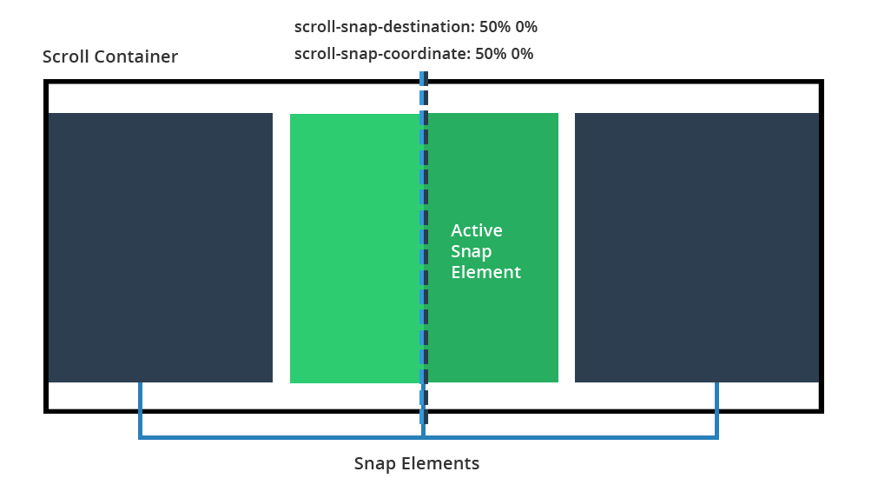

Slide 9
React Navbar Menu
The navbar is a crucial part of any website as it allows easy navigation between pages and sections of the site.
create a new component called Navbar and import it into our App.js file. Inside the Navbar component, we will create a container element that will hold our navbar links.
We will then create a series of links using the react-router-dom library. This library allows us to easily handle routing in our React app. We will create a Link element for each page or section of our site and specify the path to that page in the "to" attribute.

Slide 10

Material-UI Icons with React
Material-UI is a popular React UI library that provides a set of reusable and customizable UI components, including icons. Material-UI Icons is a collection of icons that can be used in React applications to add visual elements and improve the user experience.
To use Material-UI Icons in a React project,
npm install @material-ui/icons

Slide 11
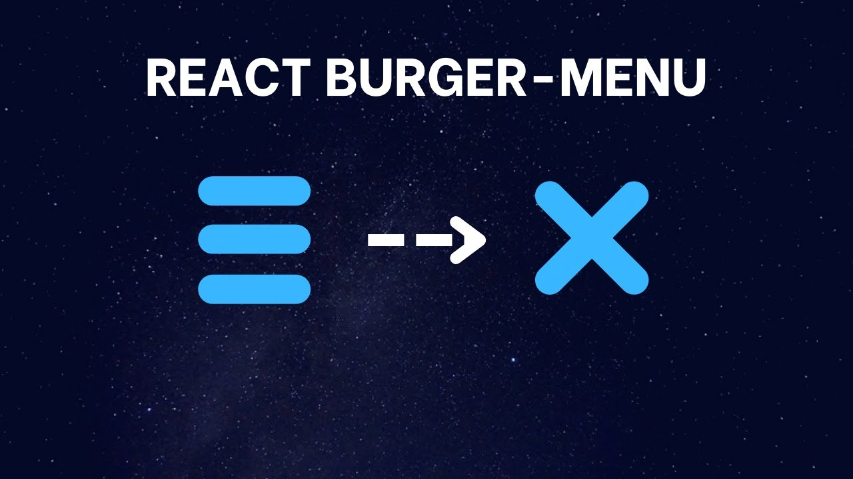
React Animated Hamburger menu:
React Animated Hamburger Menu is a popular component used in web development. It is a navigation menu that appears as a set of three horizontal lines, resembling a hamburger. When clicked, the menu expands to show a list of menu items. The animation effect of the hamburger menu is what sets it apart from other navigation menus.
To create an animated hamburger menu in React, you can use a combination of CSS and JavaScript. First, create a hamburger icon using three div elements with a class name of "hamburger". Then, add CSS styles to create the lines of the hamburger icon.

Slide 12
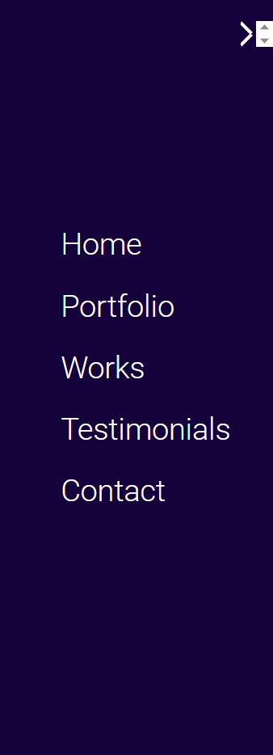
React Sidebar menu:
A sidebar menu is a common user interface element used in many web applications. In a React application, you can create a sidebar menu using various techniques. One way is to use a React component library that provides pre-built sidebar menu components. Another way is to create your own custom sidebar menu component from scratch.

Slide 13
React adding dynamic active class:
To add a dynamic active class in React, you can use the useState hook to keep track of the active class and update it based on user interaction or other conditions.
React dynamic data with useEffect hook:
The useEffect hook in React can be used to perform side effects, such as fetching data from an API, and updating the state of a component. Here is an example of using the useEffect hook to fetch data from an API and update the state of a component dynamically

Slide 14
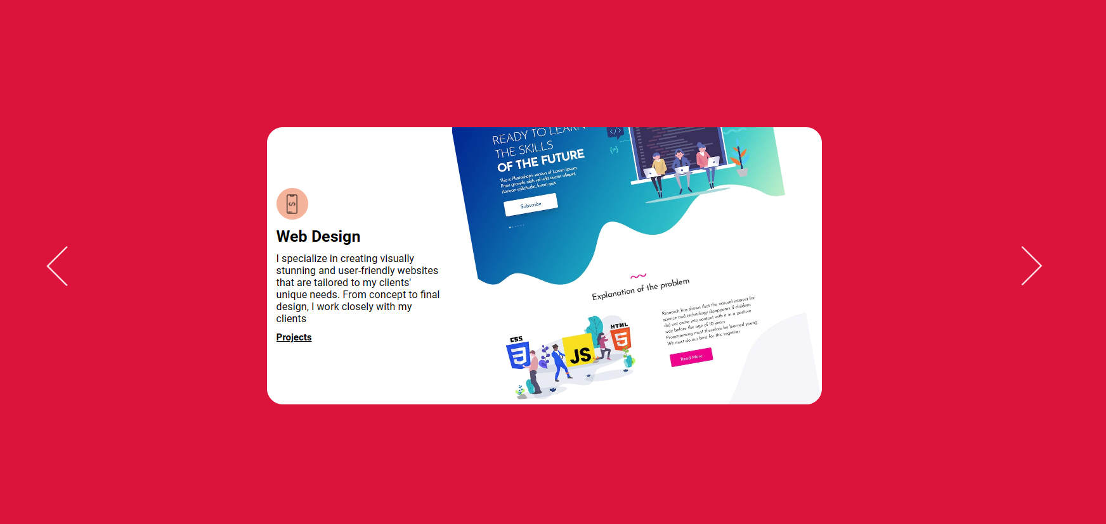
React Slider:
To create a slider in React, you can use various libraries like react-slick, react-slider, swiper, etc. Here's an example using react-slick:
First, install the library using npm or yarn:
Import the necessary files in your component:
Define your slider component and add your content as div elements inside the Slider component:
Finally, use the MySlider component in your application as desired.
This is just a simple example, and you can customize the slider behavior, styling, and content as per your requirements using different settings and properties provided by the react-slick library

Slide 15
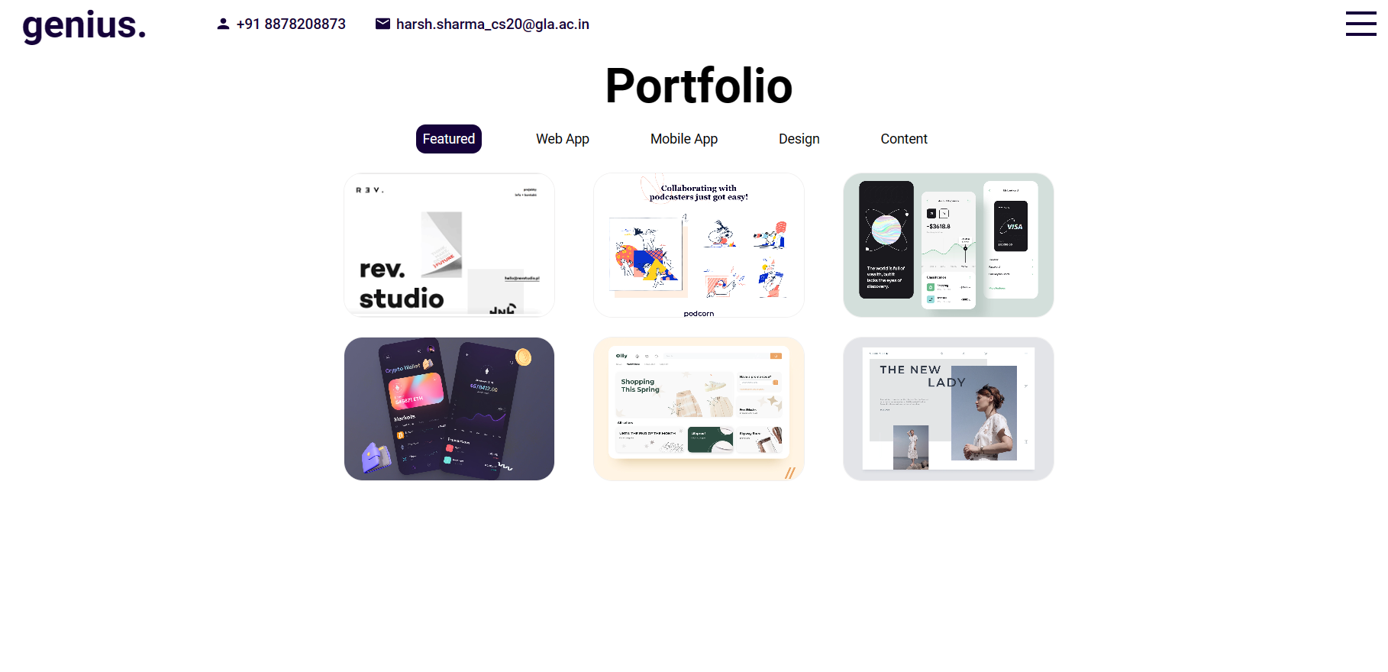

Slide 17
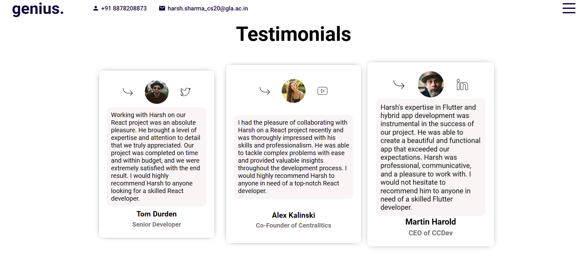

Slide 18
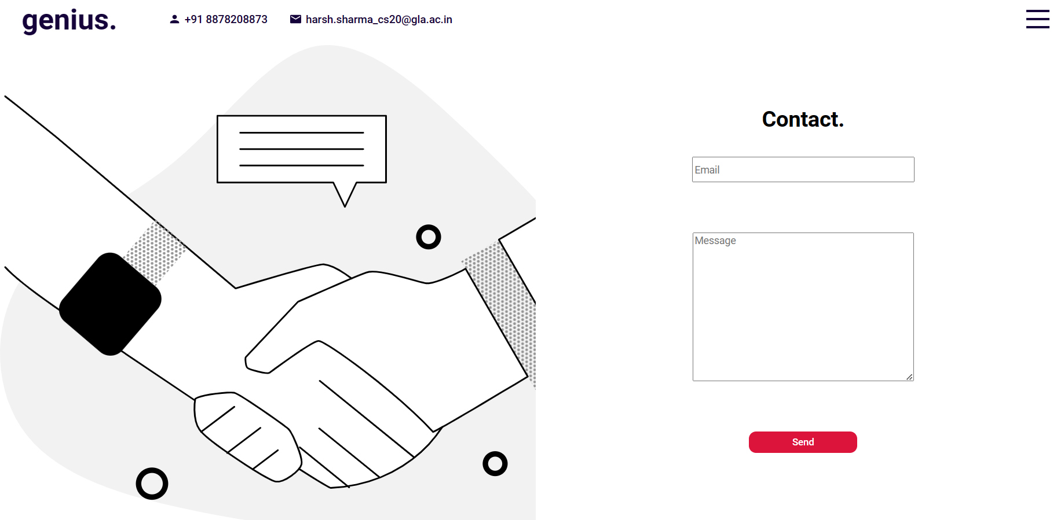

Slide 19
Conclusion
A responsive portfolio website was created using React.
The website contains a navigation bar, a home page, an about page, a projects page, and a contact page.
Each page contains relevant information and is styled to look professional and modern.
The website is fully responsive and can be viewed on various devices such as desktops, tablets, and mobile phones.
The website was successfully deployed online using Netlify.

Slide 20


